Slide 1

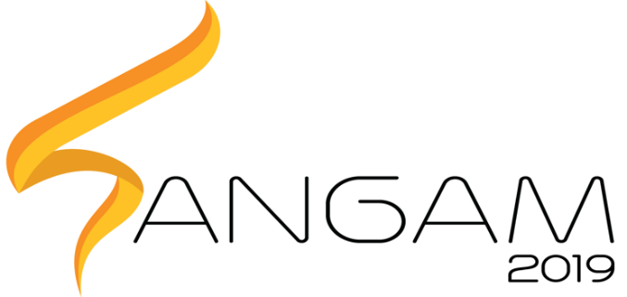
Healthcare and Medical Sciences S.P.E.A.R
PRAGYAN HARDWARE HACKATHON
Soft Pneumatic EMG Assisted Rehabilitation

Slide 2
Aim
SPEAR is an Active Ankle-Foot Orthosis(AFO), aimed at providing a cheap an affordable solution for rehabilitating stroke survivors.

Slide 3
Application
Ease of physiotherapy for those affected with stroke. Physiotherapy is a costly and continuous process, whereas a robotic solution would be a one-time investment. Because of its compliant nature, SPEAR is lighter, smaller and easier to use, contrary to traditional rigid approaches.

Slide 4
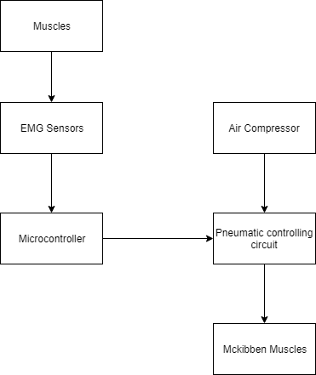
Block Diagram

Slide 5
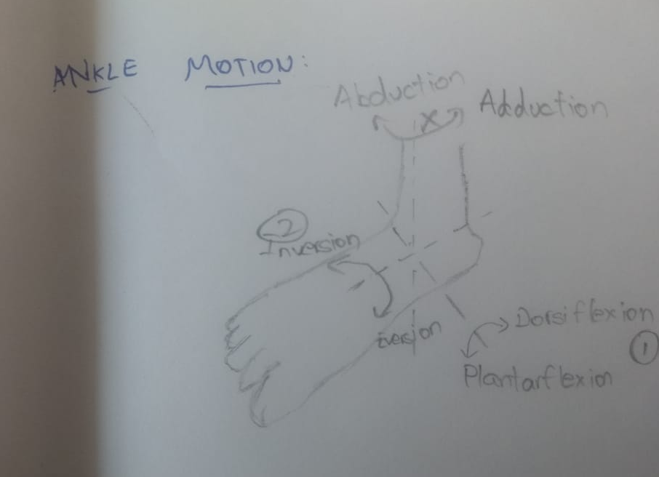
Ankle Motion

Slide 6
Progress Report
McKibben Muscles have been fabricated.
The price of a readymade McKibben muscle is minimum Rs.1500
Using off-the shelf components, cost has been reduced to an average Rs.150, depending on Muscle size, diameter
Component | Cost(Rs.)
Bladder(Silicon Rubber) | 40 - 60
Nylon Mesh Sleeve | 40 - 60
Miscellaneous (Connectors, Seals) | 50
Total | 150

Slide 7
Testing Results
Inner Diameter (inch) | Outer Diameter (inch) | Length (cm) | Slack in Nylon Weave | Contraction (cm) | Percentage Contraction
1/3 | 1/2 | 20 | No | 2.5 | 12.5
1/3 | 1/2 | 20 | Yes | 0.5 | 2.5
1/2 | 5/8 | 30 | No | 3 | 10

Slide 8
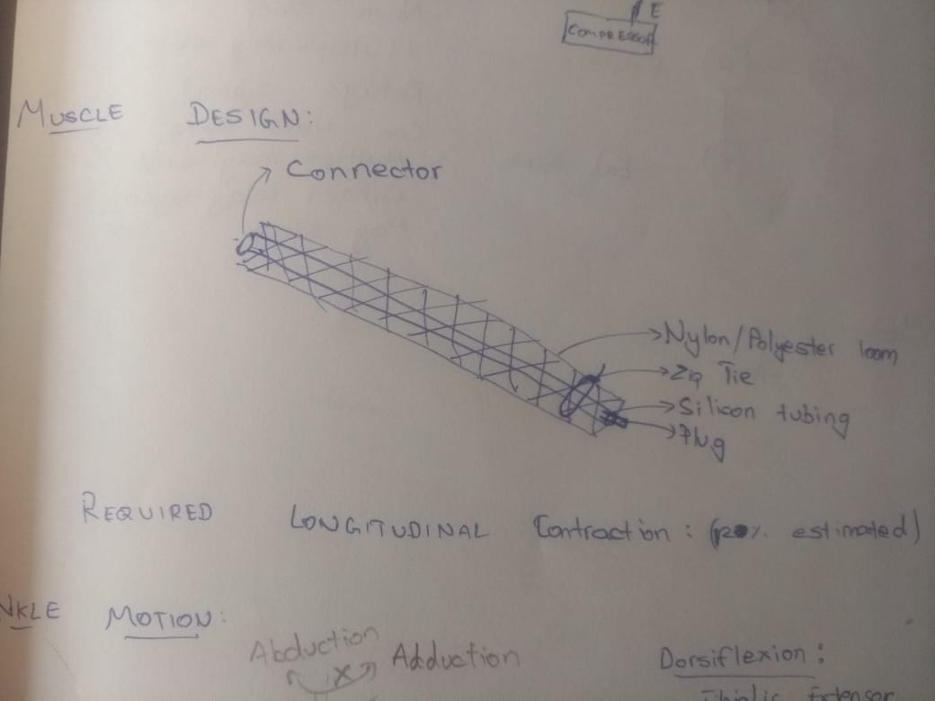
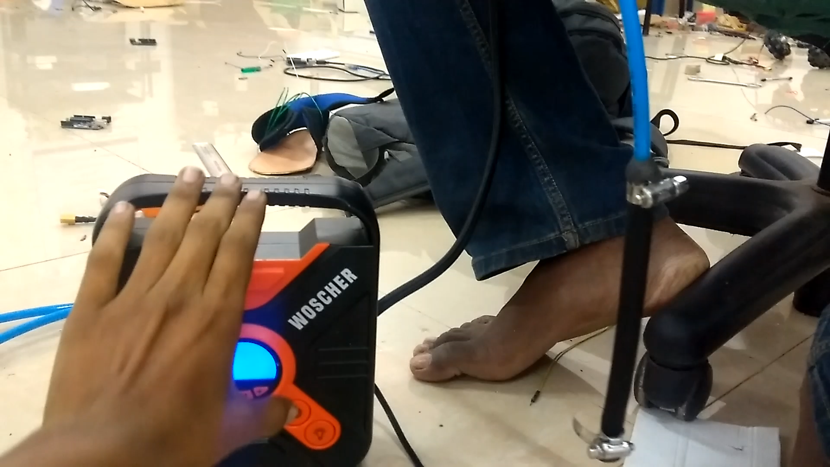
Muscle Test

Slide 9
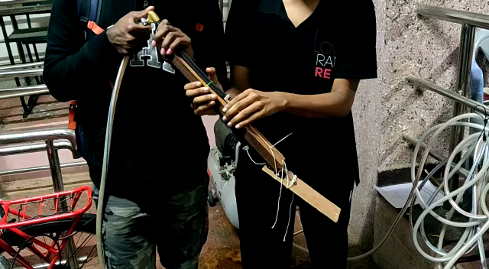
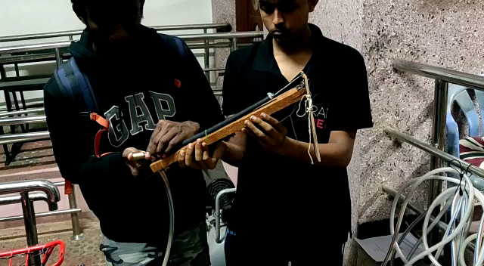
Prototype (120˚ range of motion)
Dorsiflexion
Plantarflexion

Slide 10
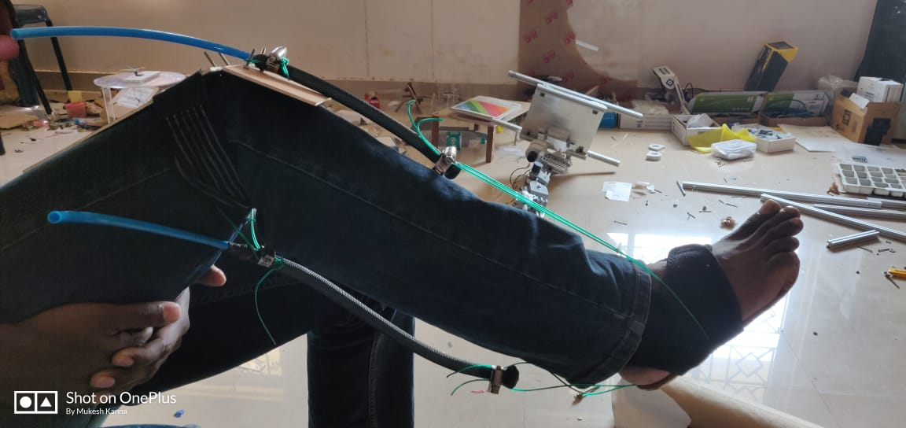
Orthosis Design

Slide 11
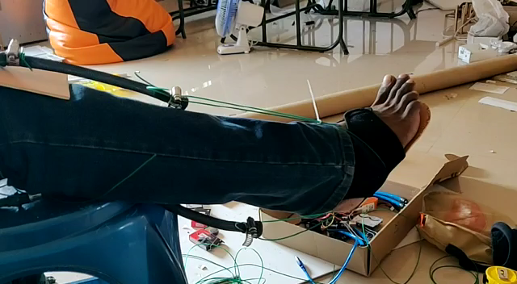
Orthosis Motion

Slide 12
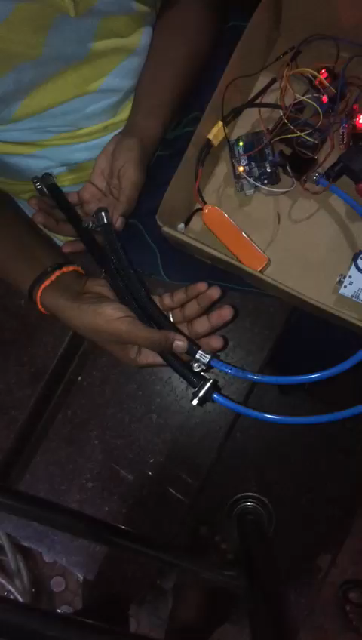
Muscle Control

Slide 13

EMG Dynamic Thresholding
Tibialis Anterior for Dorsiflexion

Slide 14
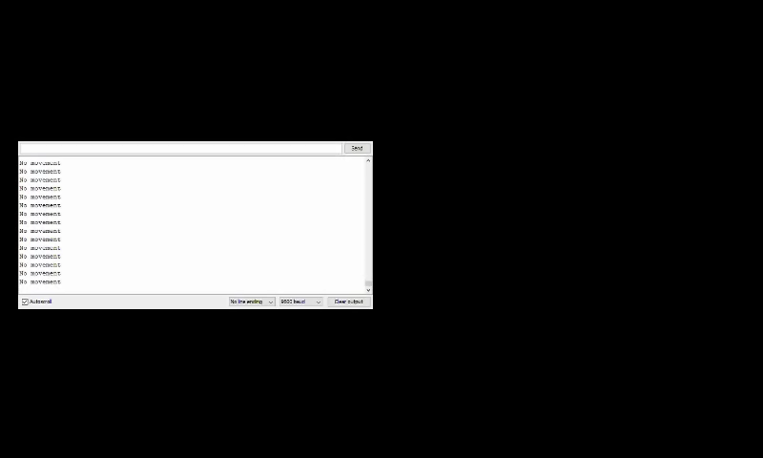
EMG Intent Estimation

Slide 15
Total Cost
Actuators: 300
Compressor: 1700
EMG Sensors: 6000
Braces: 1000
Miscellaneous(Connectors, Sealant, Tank): 500
TOTAL: <10000

Slide 16
Improvements
Integration of EMG with Orthosis
Addition of an Air Tank

